Slide 1
WHAT IS DESIGN

Slide 2
Design is what links creativity and innovation. It shapes ideas to become practical and attractive propositions for users or customers.

Slide 3
Types of Design

Slide 4
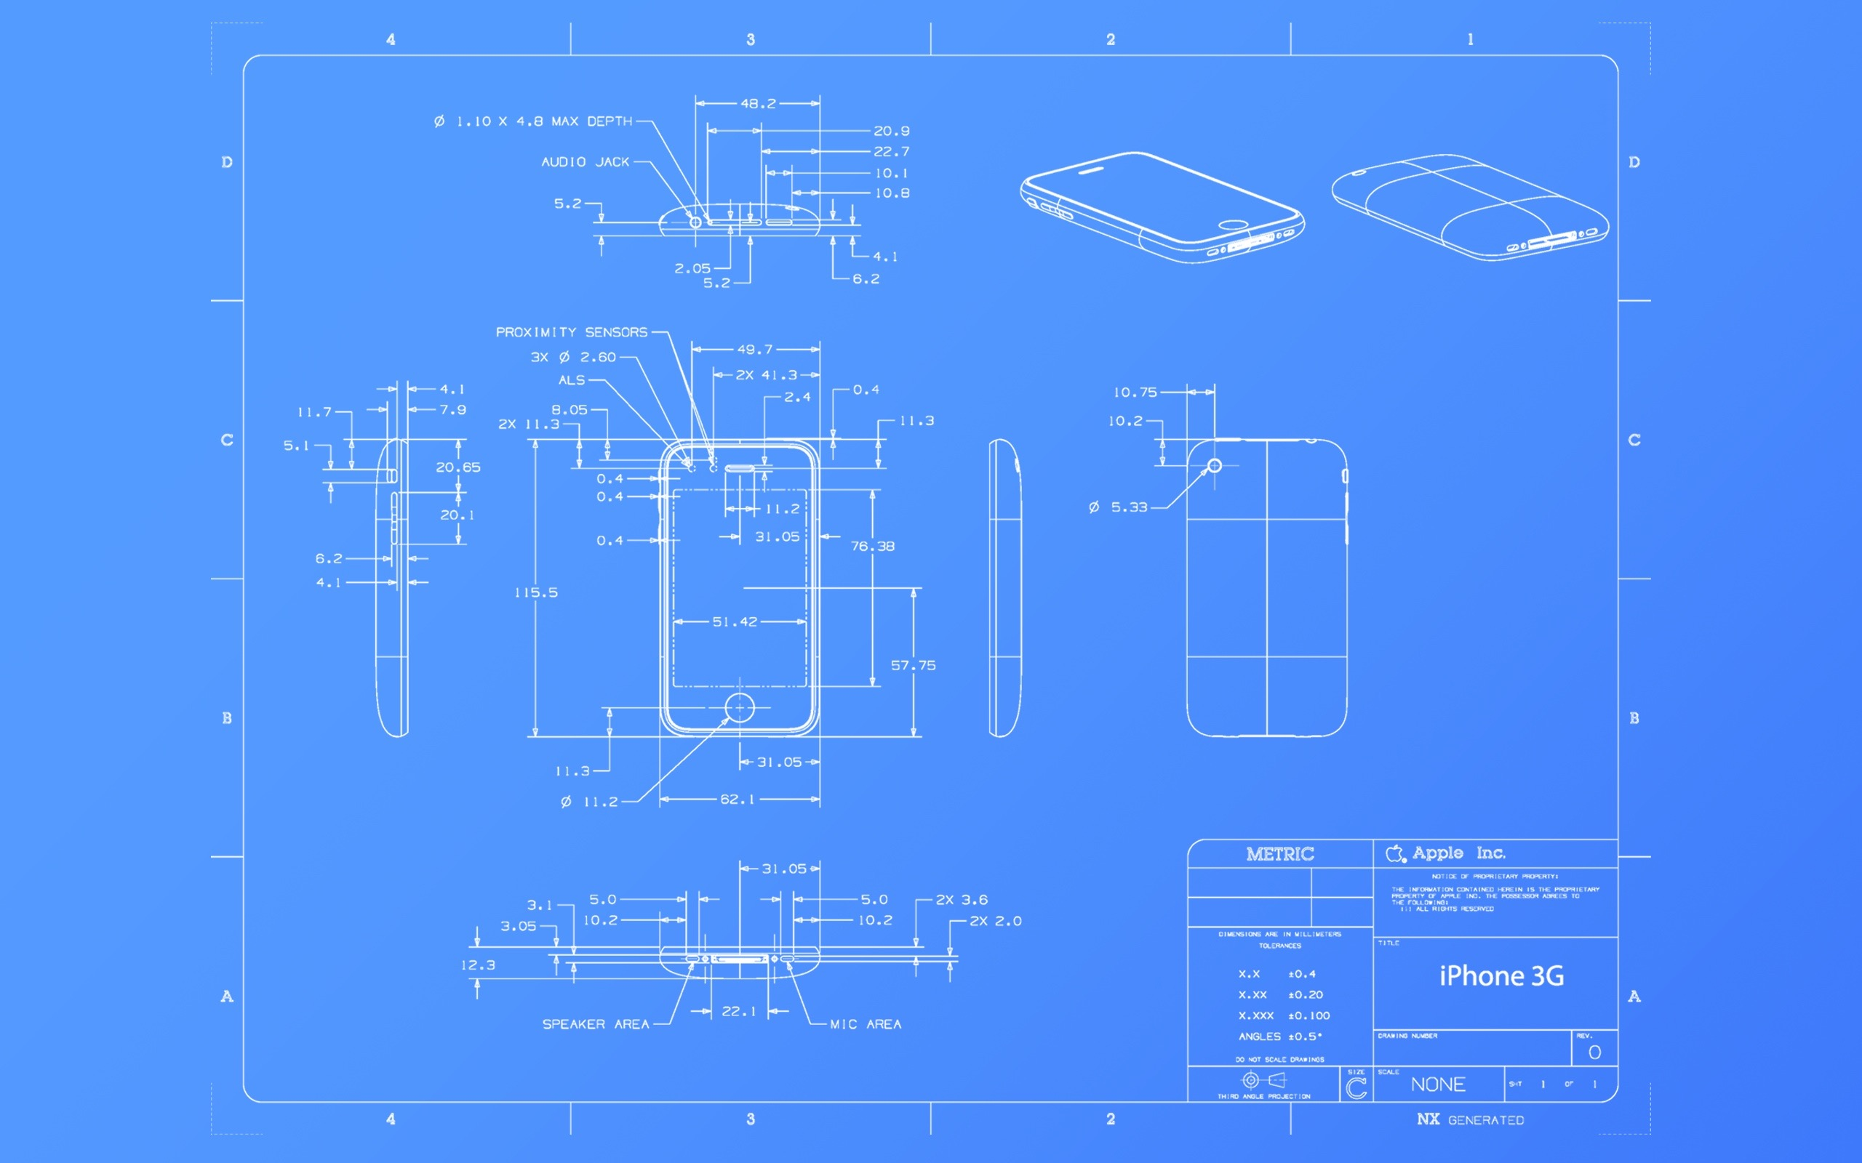
Product Design

Slide 5
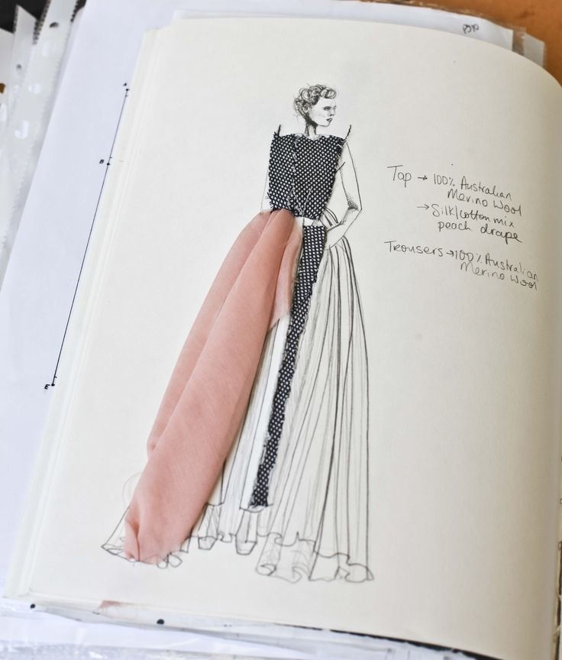
Fashion Design

Slide 6
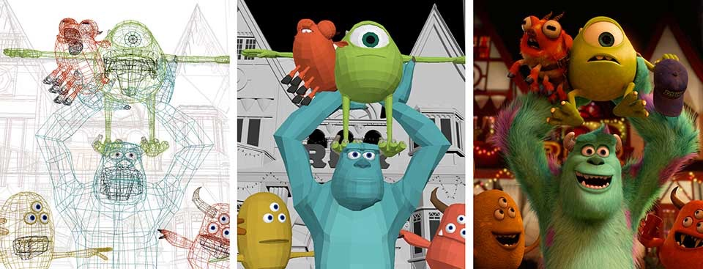
Multimedia and animation

Slide 7
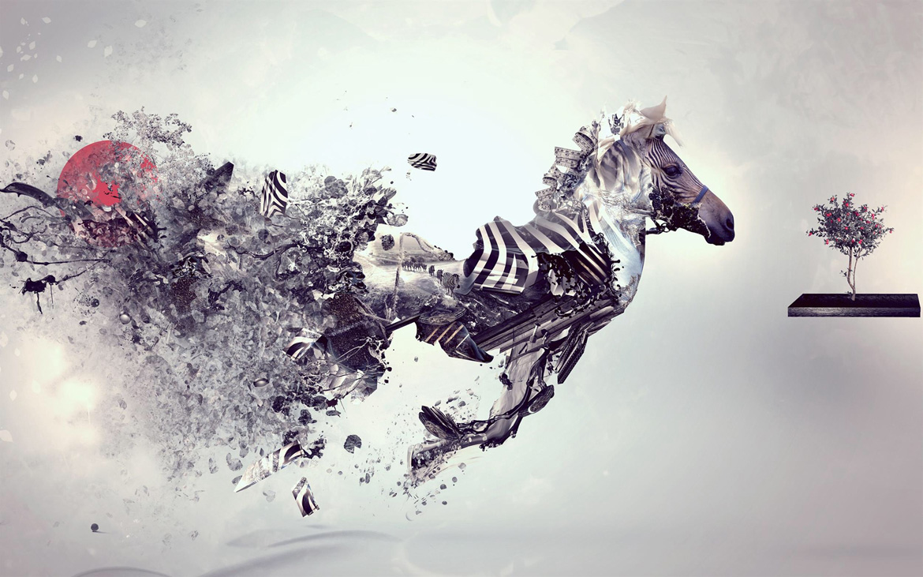
Graphic Design

Slide 8
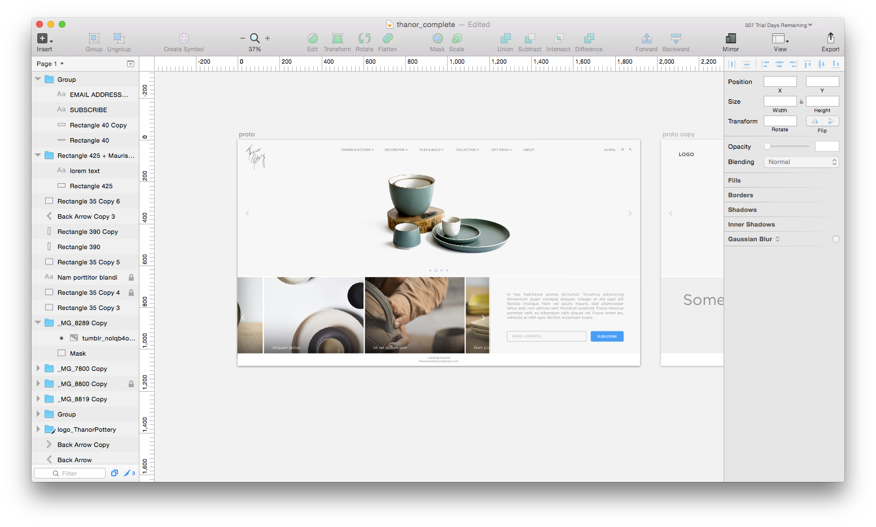
Web Design

Slide 9
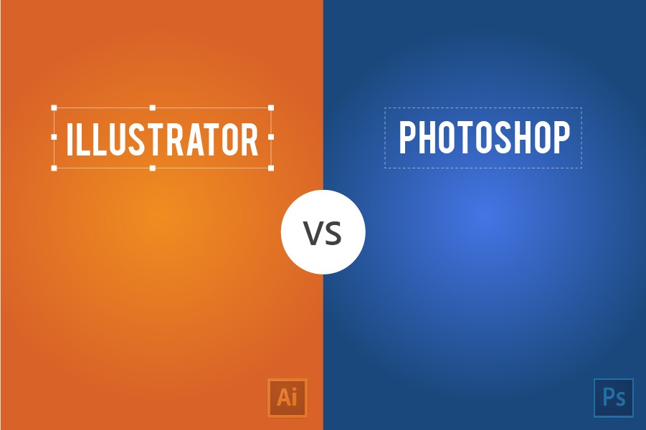
and

Slide 10
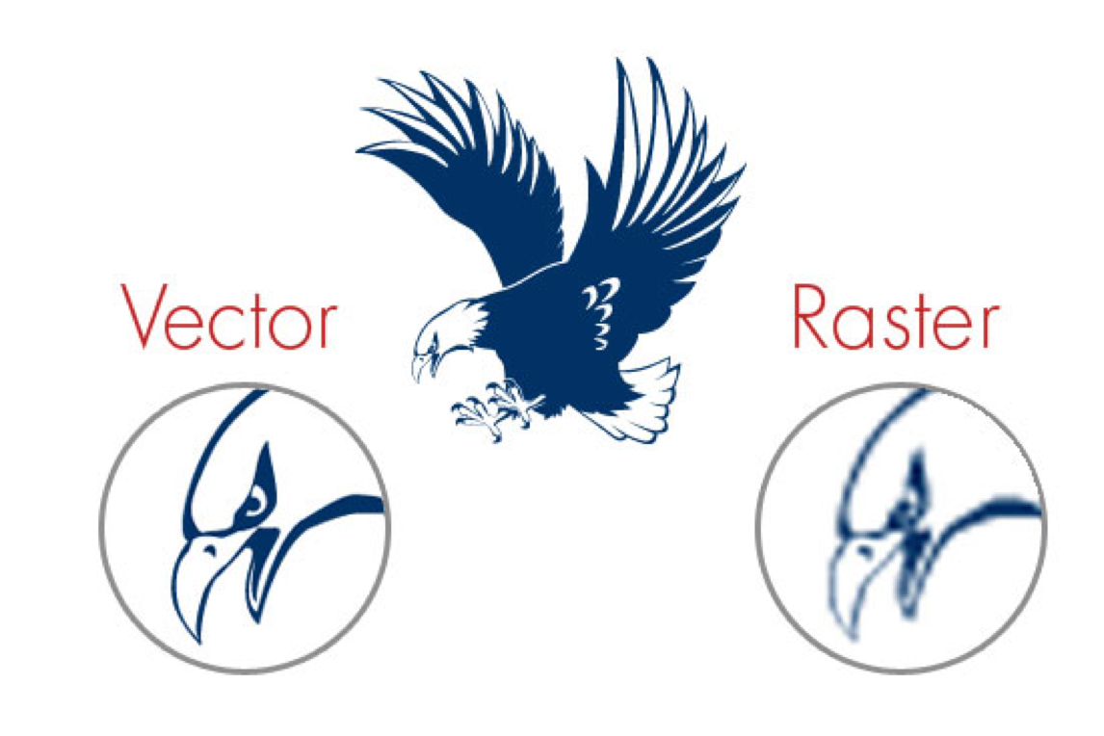
https://www.pinterest.com/pin/355362226823109423/

Slide 11

Layers

Slide 12
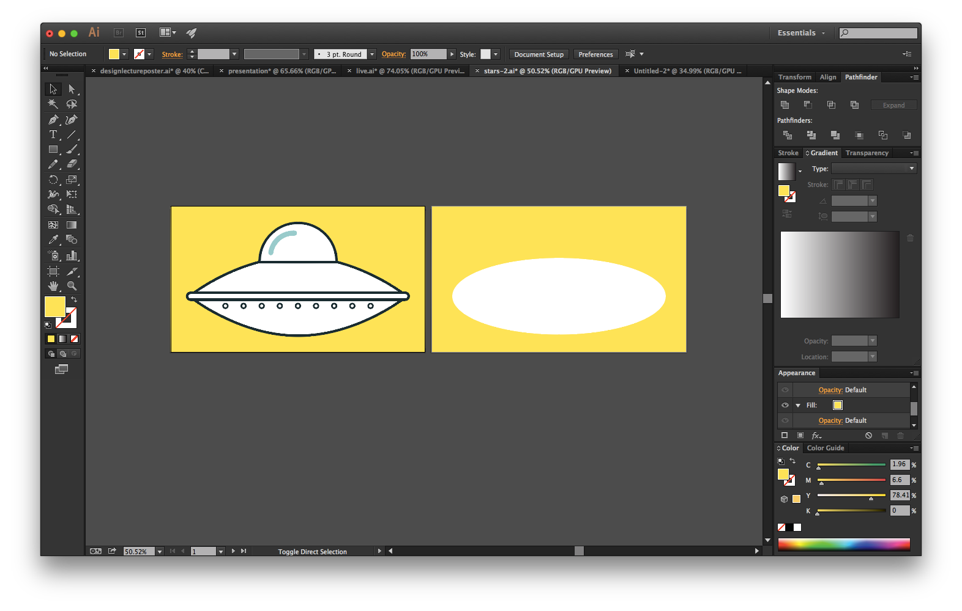

Slide 13
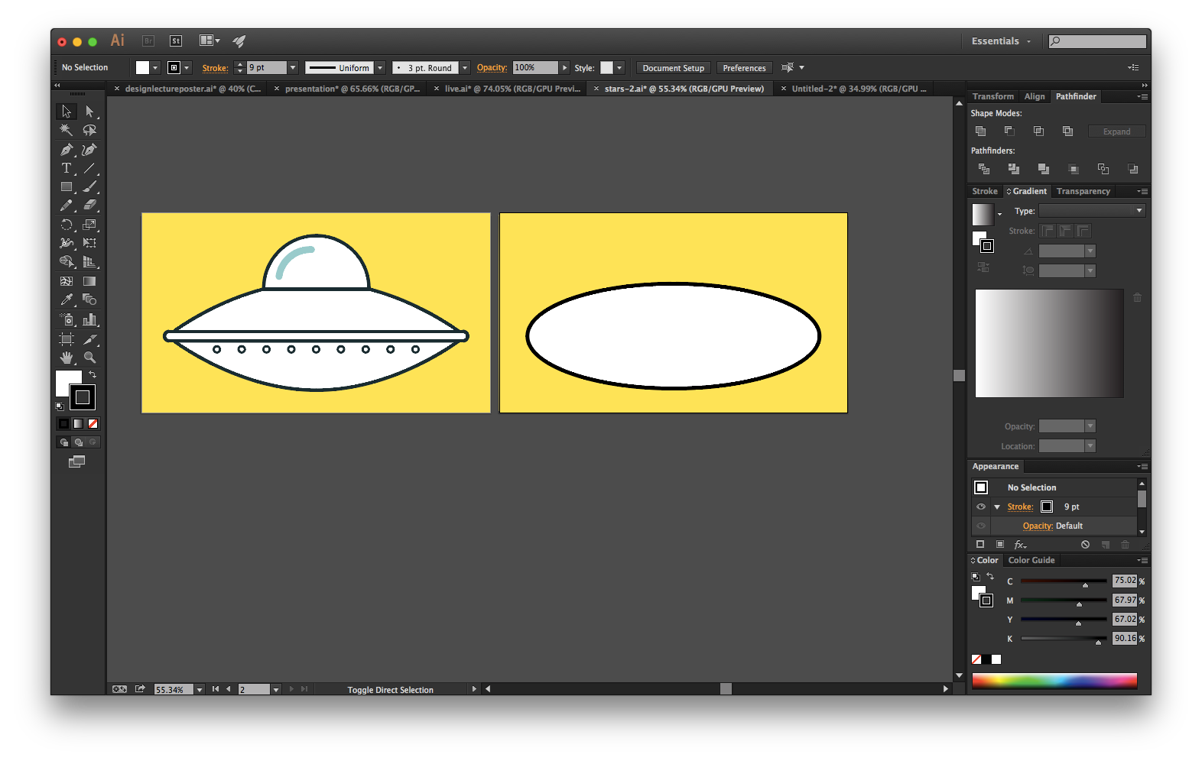

Slide 14


Slide 15


Slide 16


Slide 17
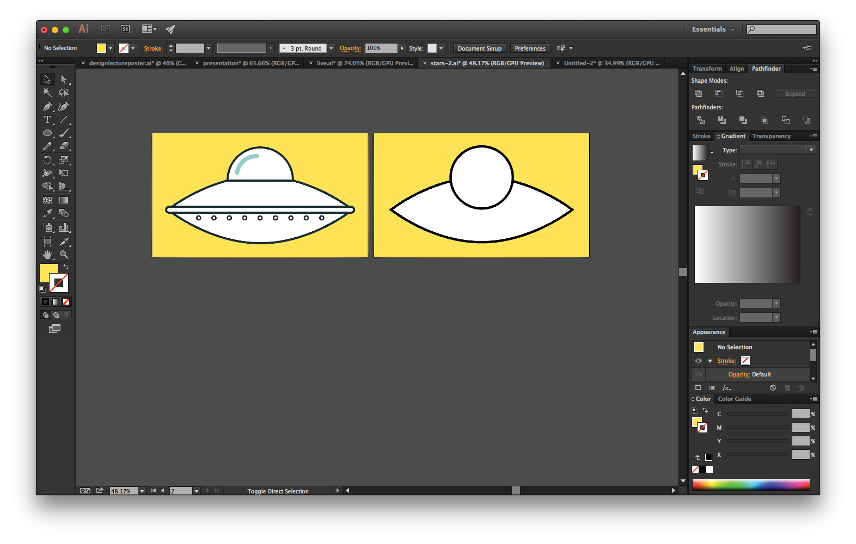

Slide 18
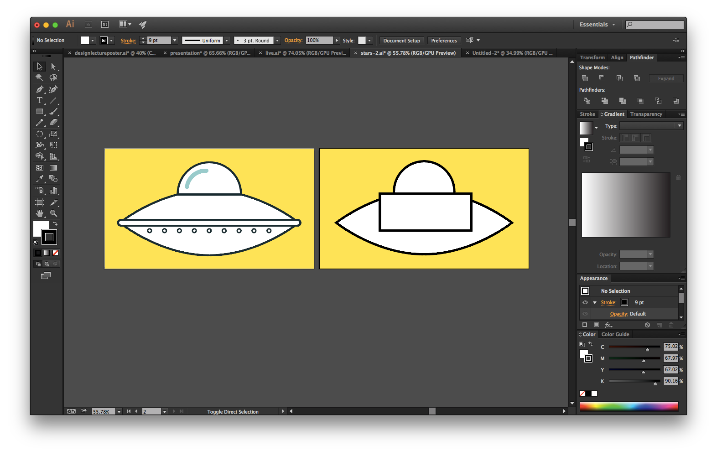

Slide 19


Slide 20
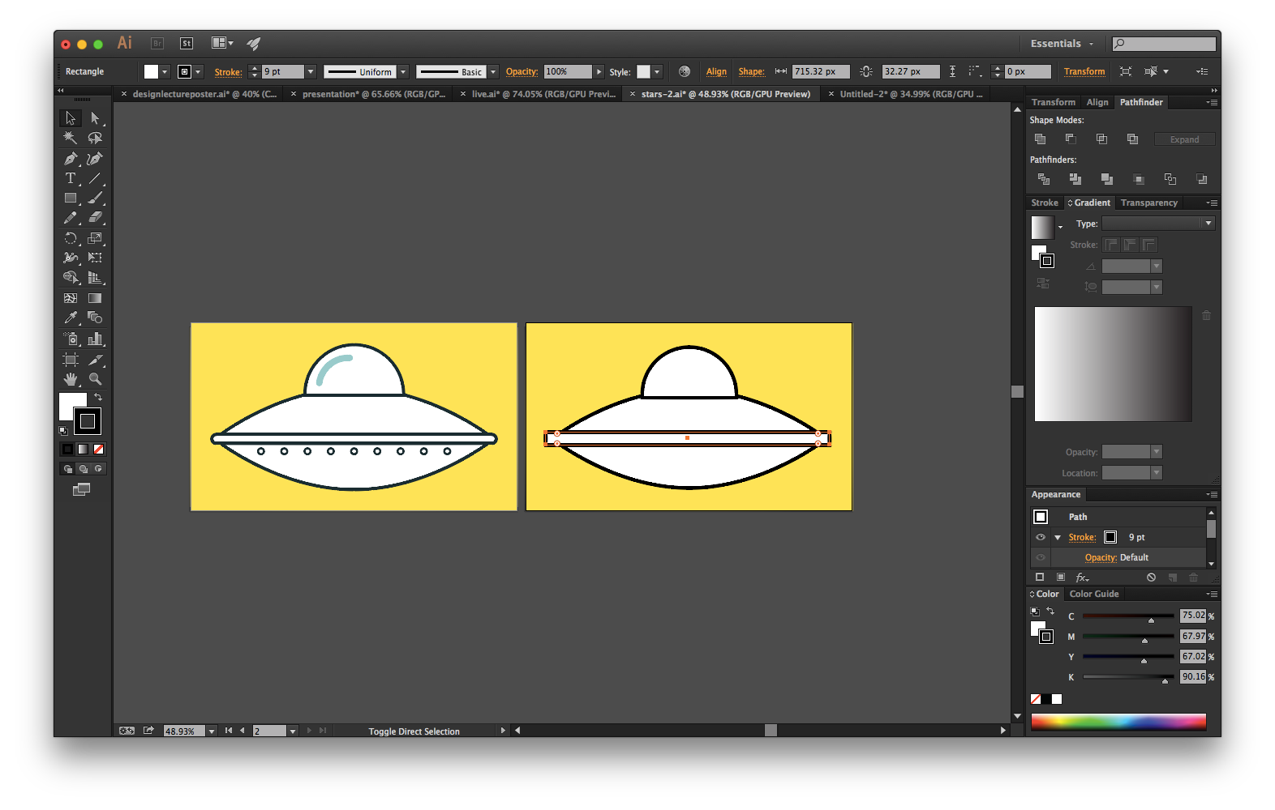

Slide 21
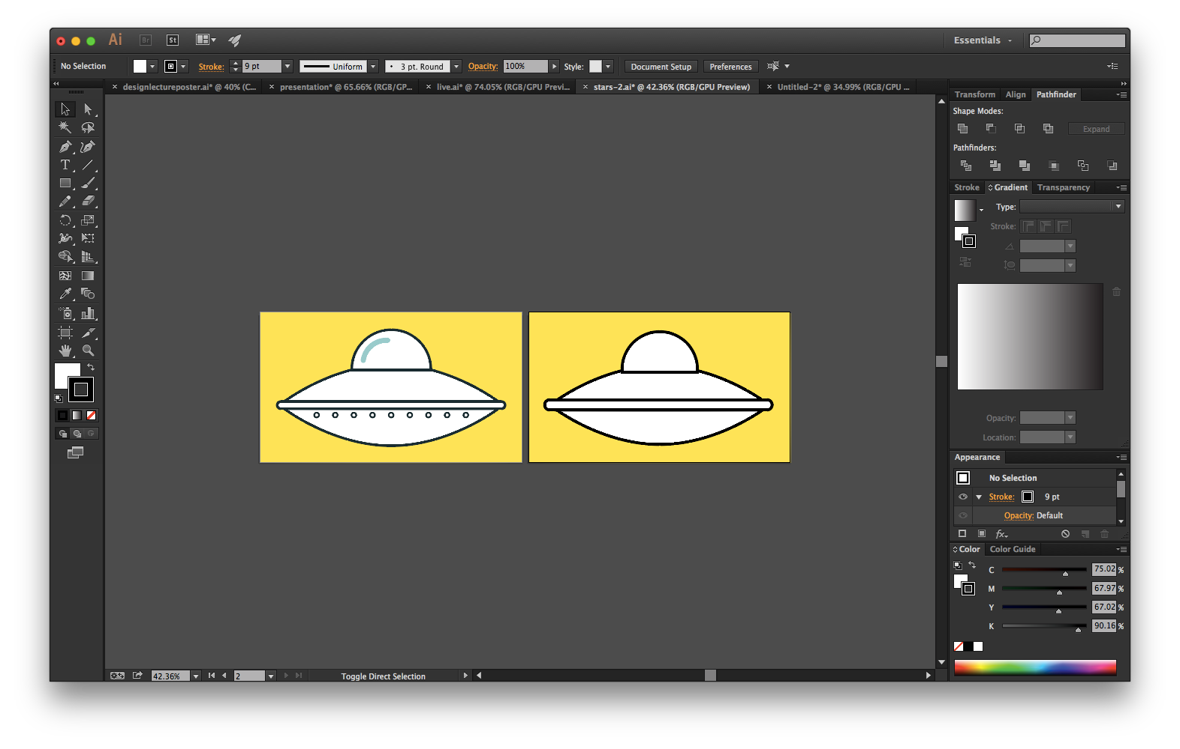

Slide 22
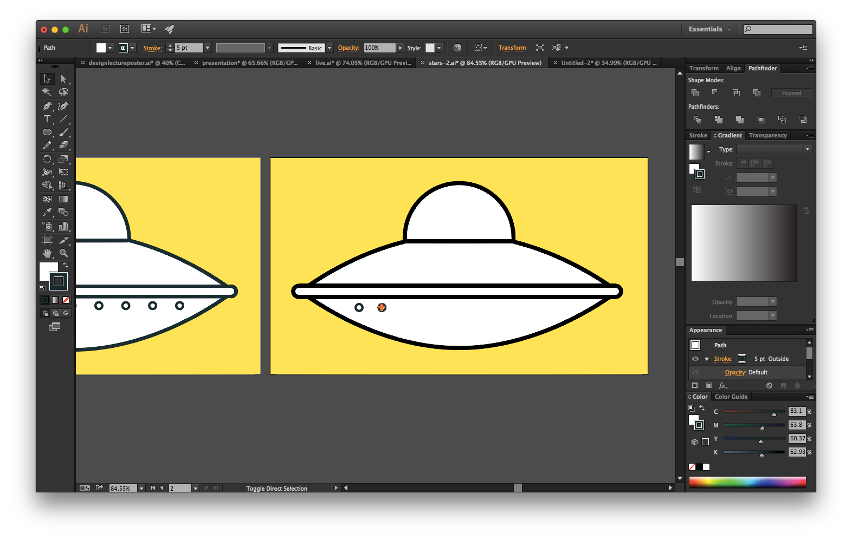

Slide 23
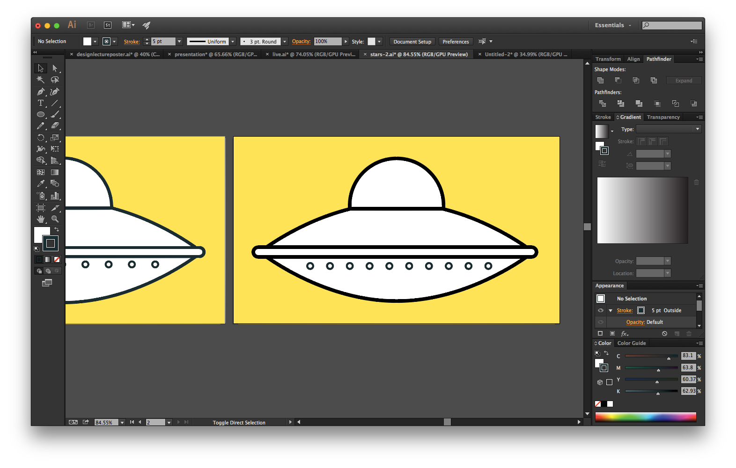

Slide 24
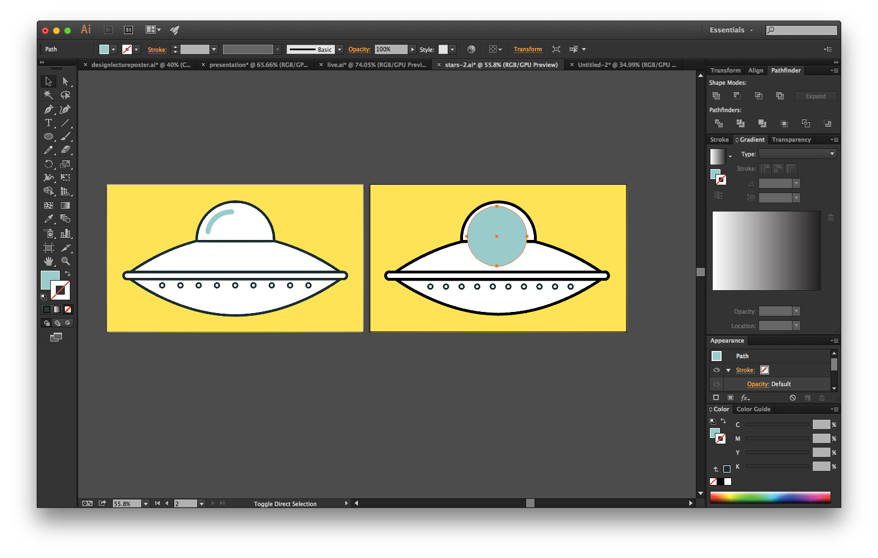

Slide 25
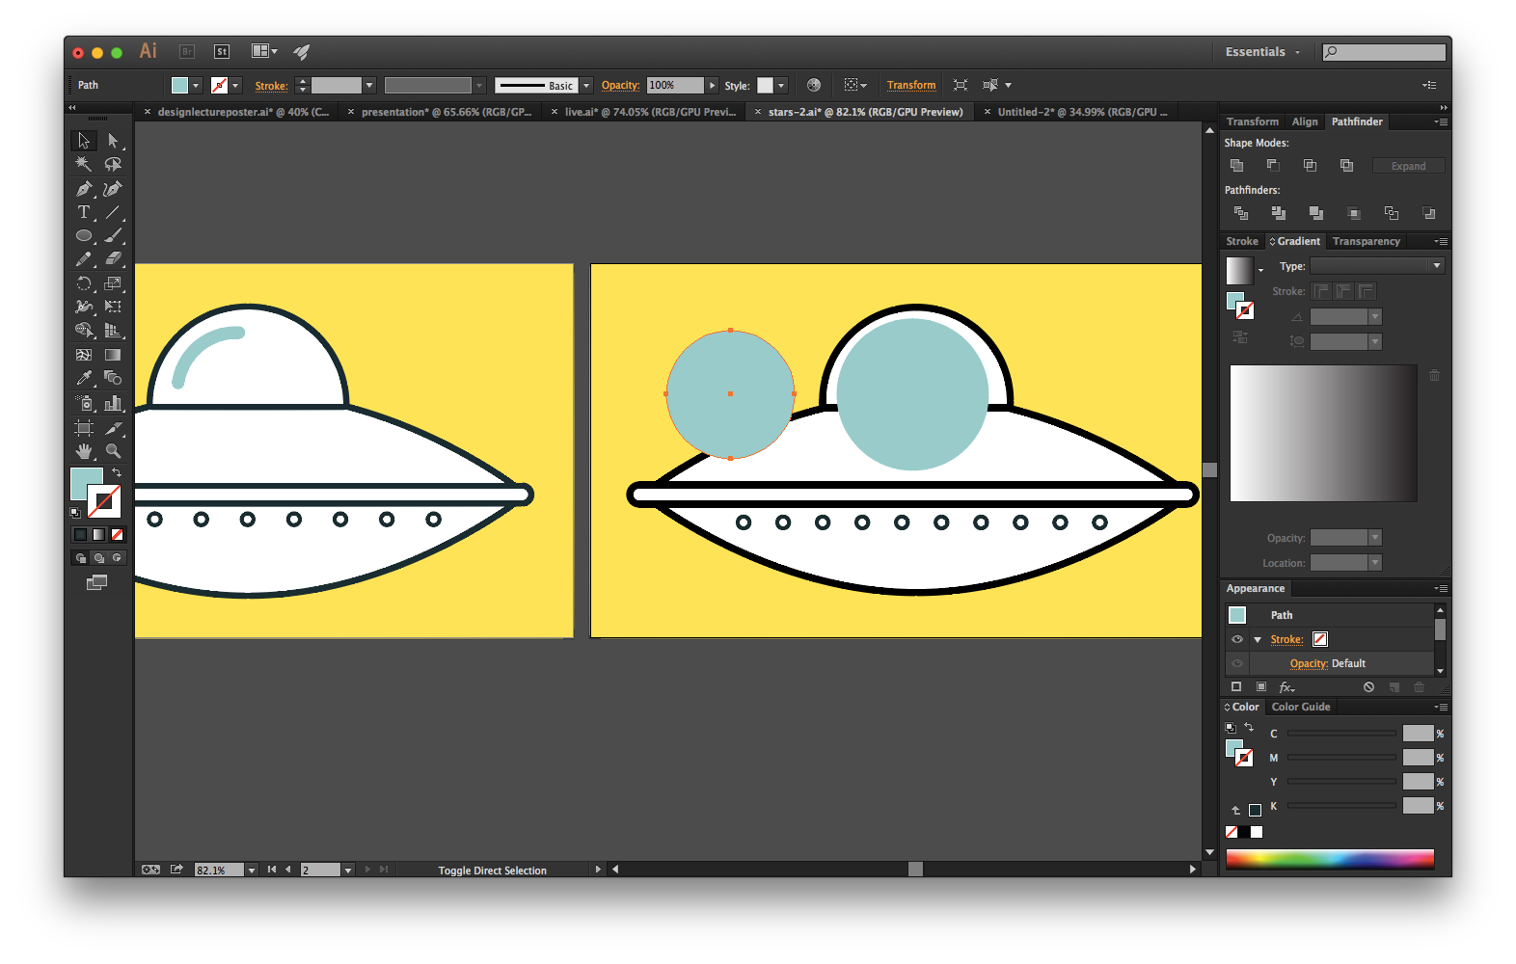

Slide 26
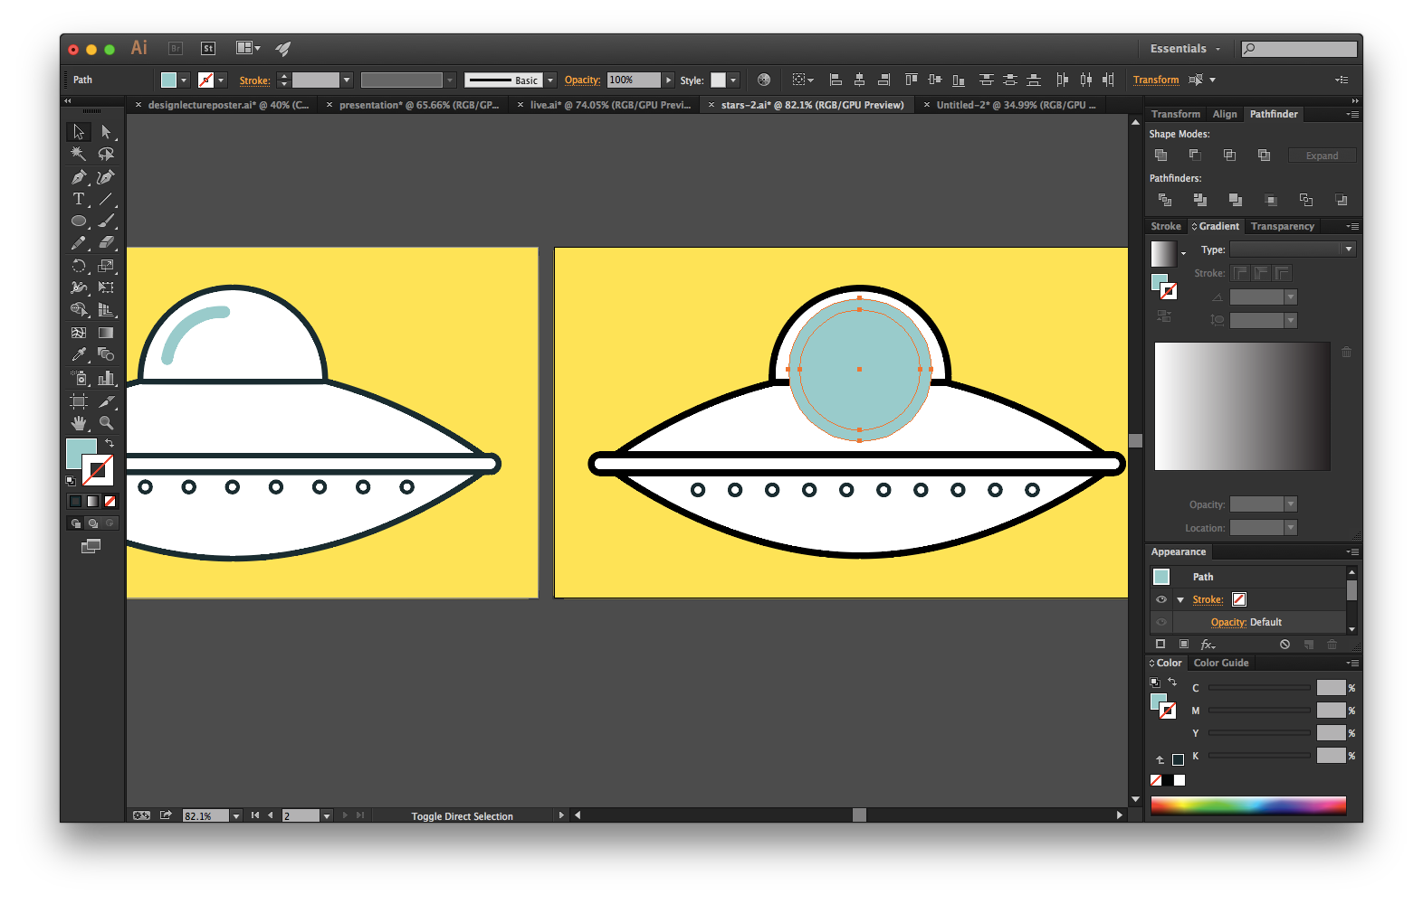

Slide 27
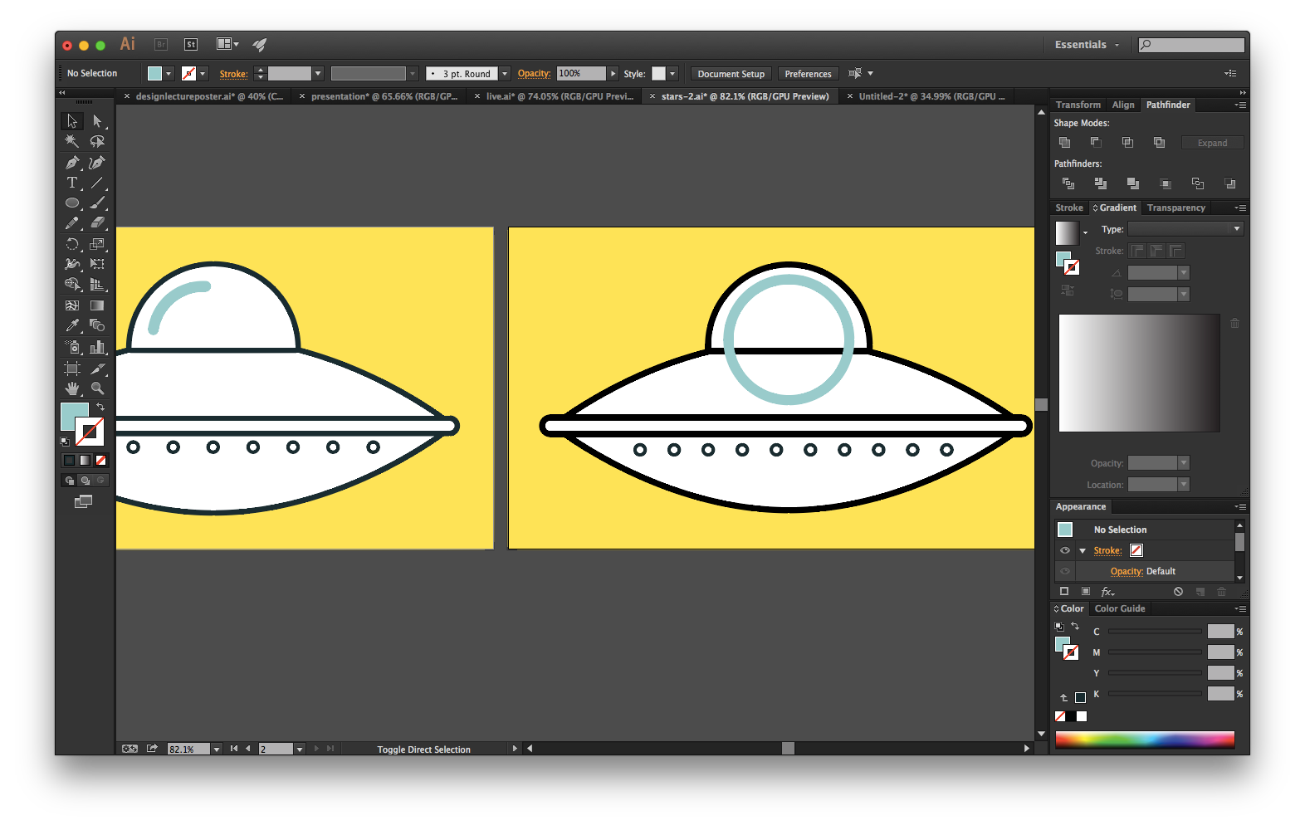

Slide 28
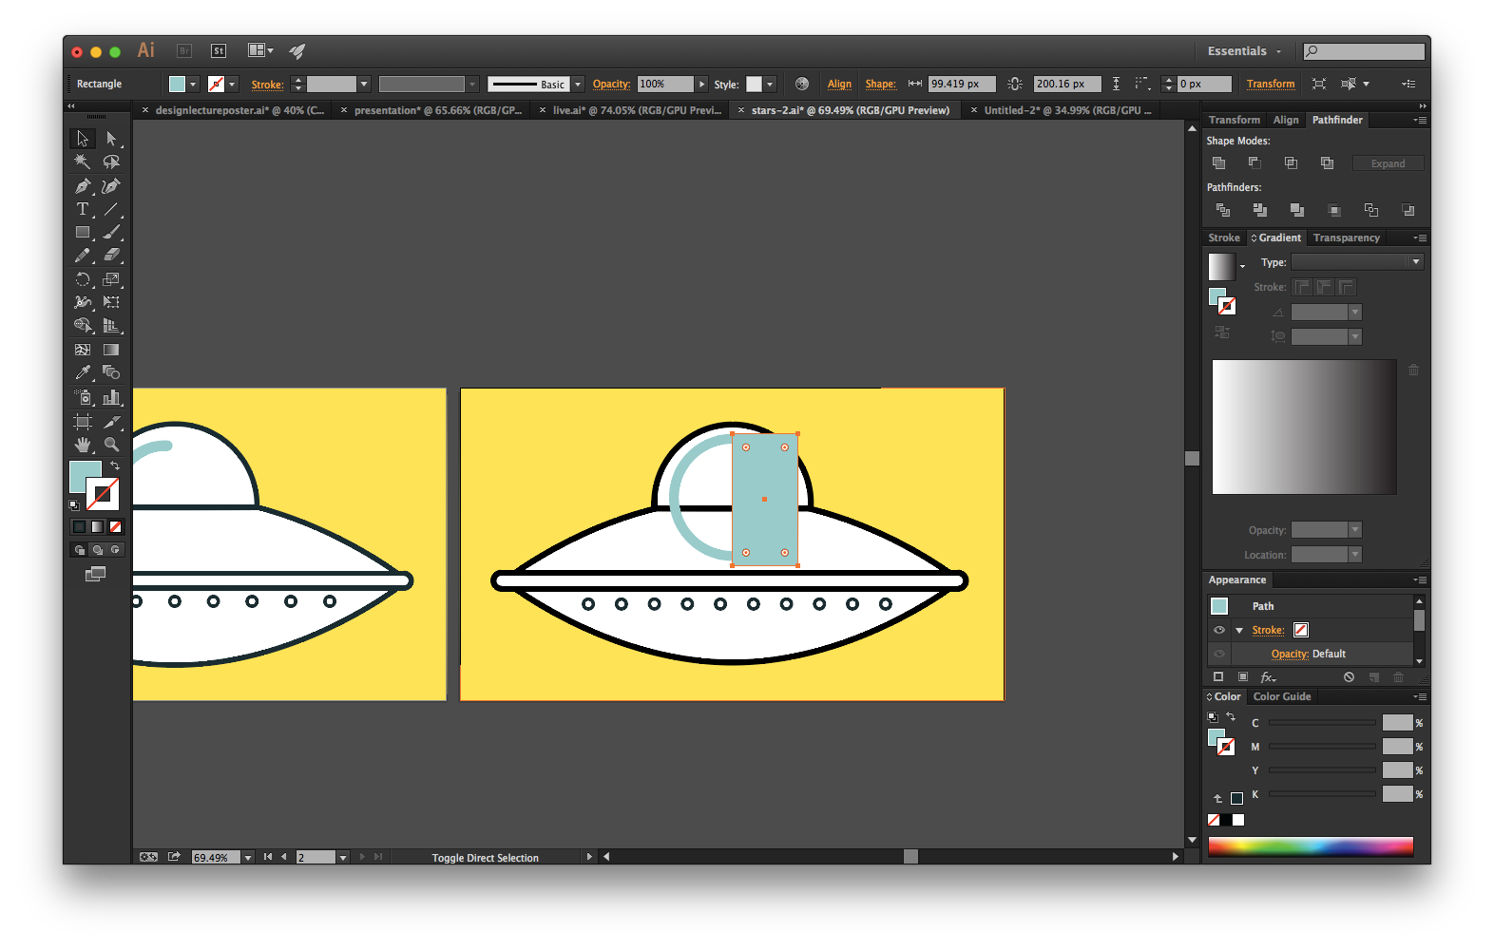

Slide 29
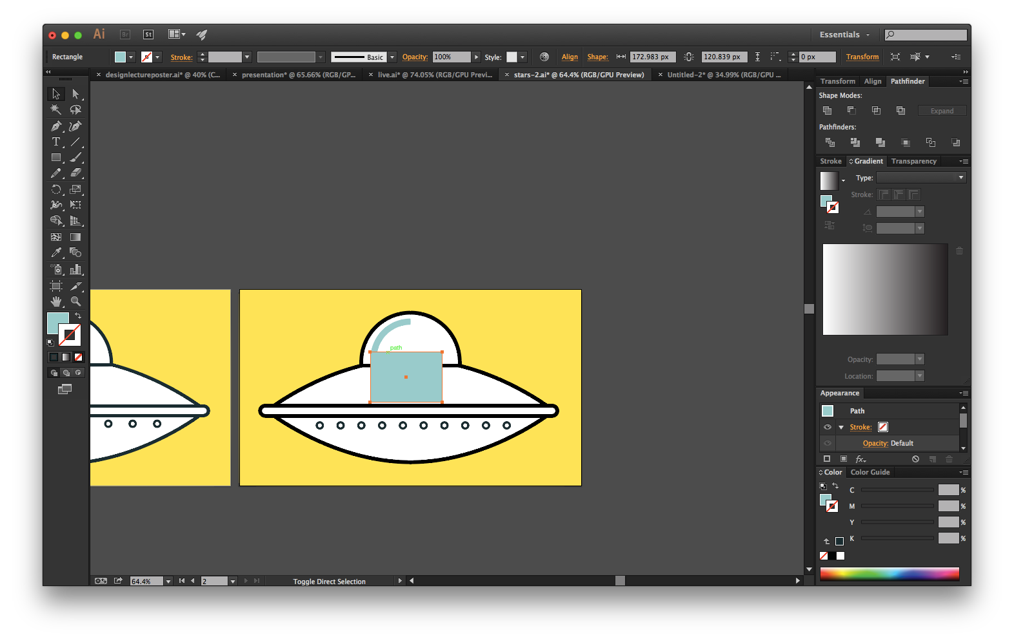

Slide 30
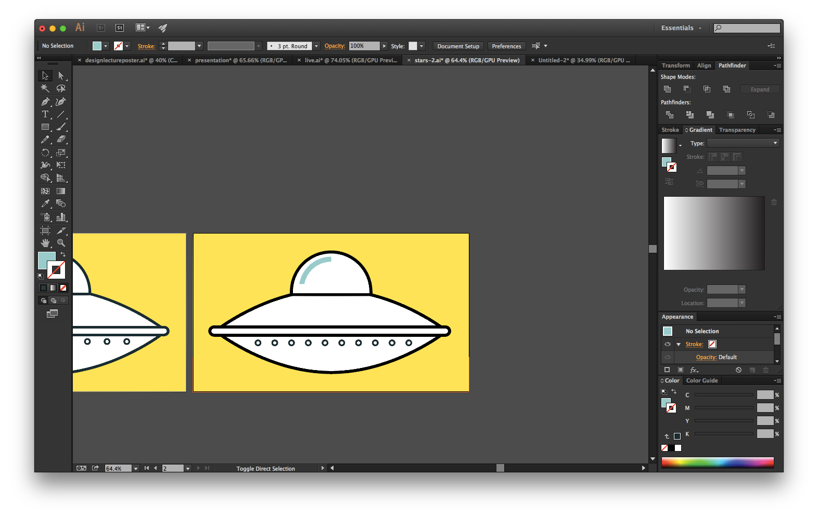

Slide 31
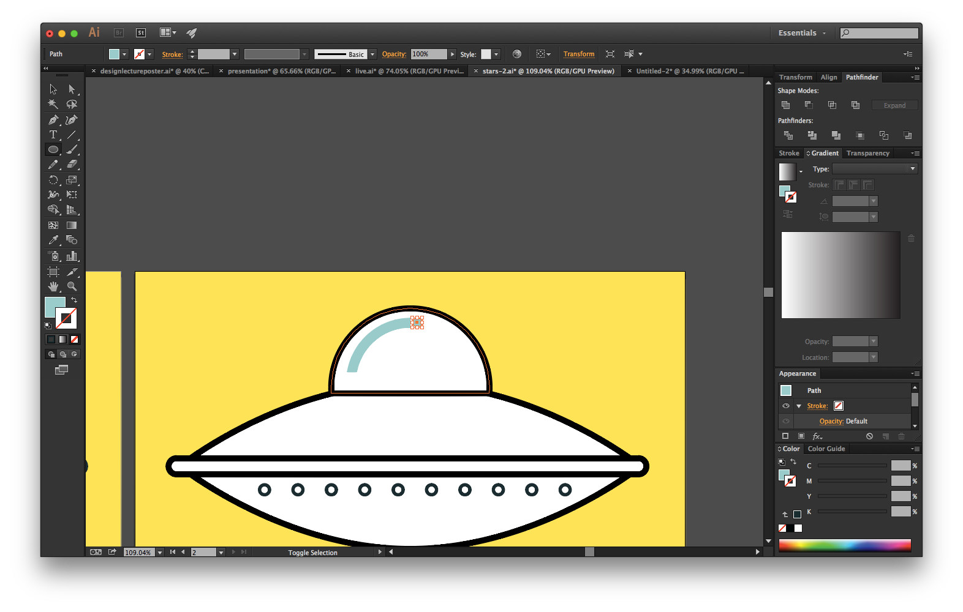

Slide 32
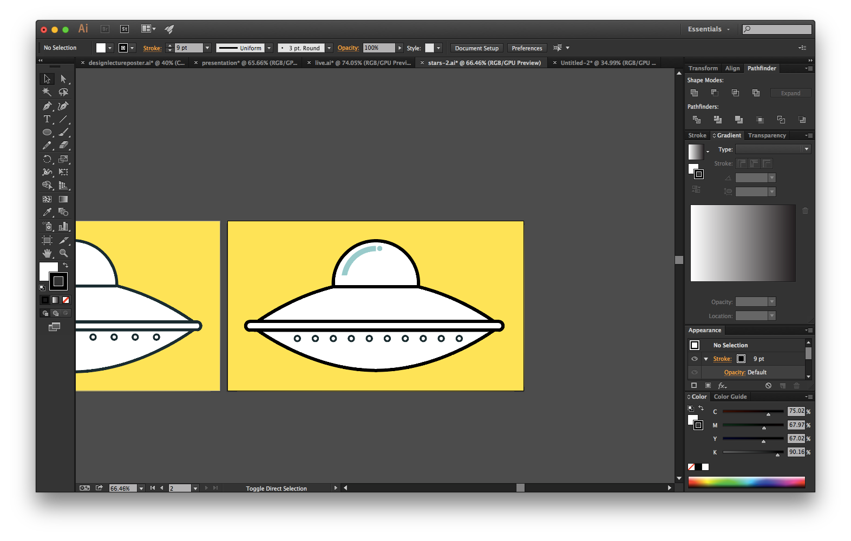

Slide 33
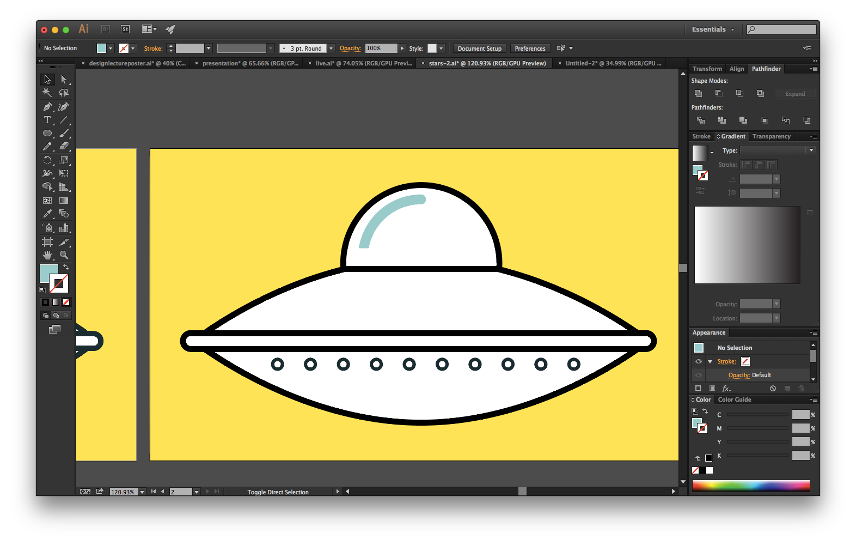

Slide 34
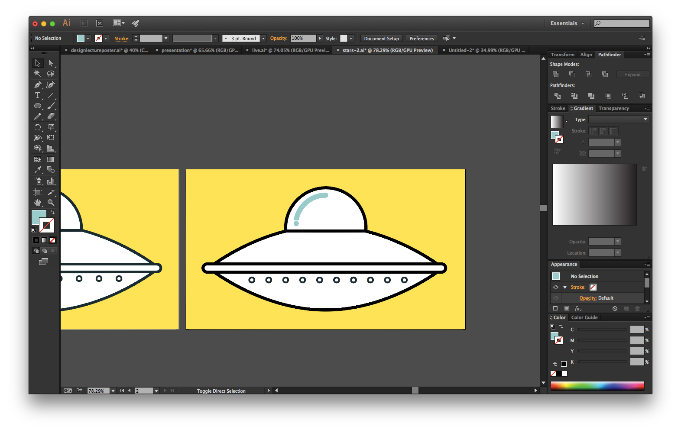

Slide 35
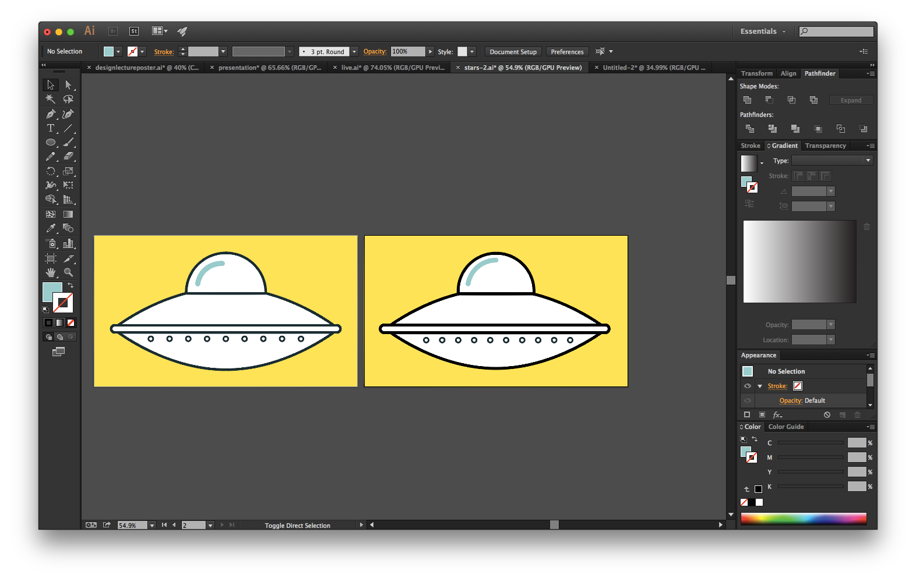

Slide 36


Slide 37
RESOURCES
helpx.adobe.com/in/illustrator.html
http://design.tutsplus.com/
http://www.lynda.com/in/Illustrator

Slide 38
THANK YOU
facebook.com/sdslabs
chat.sdslabs.co

